Slide 1
Fundamental Network Programming
Stream in C#
Lecturer: MSc. Dang Le Bao Chuong
Spring 2022

Slide 2
Agenda
What is stream data structure / processing ?
Stream in C#

Slide 3
Stream
A sequence of data element made available for processing overtime
Stream processing vs. batch processing:
Batch processing: data is collected over a period of time, and fed into the data processor (give your examples when to use batch processing)
Stream processing: data (byte-chunks) is fed into the data processor one-by-one/piece-by-piece (buffer_size) consistently overtime (give your example when to use stream processing)
Hint: delay-tolerant vs. real-time application

Slide 4


Stream
InputStream read data from source to program
OutputStream write data from program to destination source

Slide 5
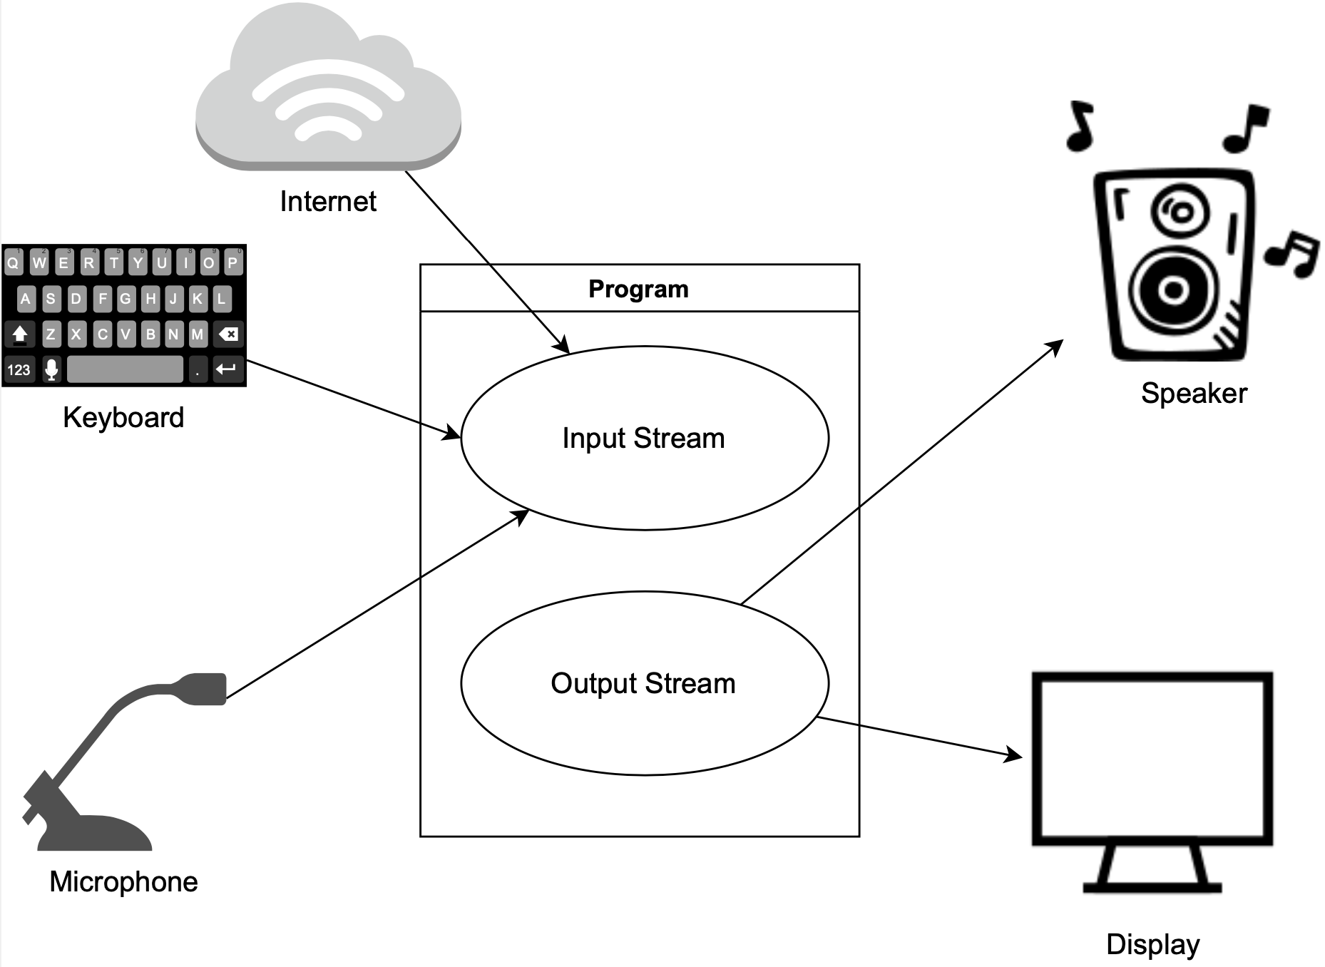
Stream

Slide 6
C# Stream
Stream: System.IO.Stream is an abstract class that provides standard methods to transfer bytes (read, write, etc.) to the source
FileStream reads or writes bytes from/to a physical file, whether it is a .txt, .exe, .jpg, or any other file. FileStream is derived from the Stream class
MemoryStream: MemoryStream reads or writes bytes that are stored in memory
BufferedStream: BufferedStream reads or writes bytes from other Streams to improve certain I/O operations' performance
NetworkStream: NetworkStream reads or writes bytes from a network socket
CryptoStream: CryptoStream is for linking data streams to cryptographic transformations
Notes:
C# includes following standard IO (Input/Output) classes to read/write from different sources like files, memory, network, isolated storage, etc.

Slide 7
C# Stream
StreamReader: StreamReader is a helper class for reading characters from a Stream by converting bytes into characters using an encoded value. It can be used to read strings (characters) from different Streams like FileStream, MemoryStream, etc.
StreamWriter: StreamWriter is a helper class for writing a string to a Stream by converting characters into bytes. It can be used to write strings to different Streams such as FileStream, MemoryStream, etc.
BinaryReader: BinaryReader is a helper class for reading primitive datatype from bytes.
BinaryWriter: BinaryWriter writes primitive types in binary
Notes:
C# includes following standard IO (Input/Output) classes to read/write from different sources like files, memory, network, isolated storage, etc.

Slide 8
How to read data from a stream
using (FileStream fs = File.Open(ofd.FileName, FileMode.OpenOrCreate))
{
using (StreamReader sr = new StreamReader(fs))
{
string s = "";
while (!sr.EndOfStream)
{
// Read it line-by-line,
s += sr.ReadLine() + "\n";
}
}
}
Notes:
Line by line

Slide 9
How to write to a file
using (FileStream fs = File.Open(sfd.FileName, FileMode.OpenOrCreate, FileAccess.ReadWrite))
{
this._currentFile = sfd.FileName;
this.Text = this._currentFile;
using (StreamWriter sw = new StreamWriter(fs))
{
sw.Write(this.richTextBox1.Text);
}
}
Notes:
Line by line

Slide 10
References
C# IO common: https://docs.microsoft.com/en-us/dotnet/standard/io/how-to-read-and-write-to-a-newly-created-data-file
BinaryReader/Writer: https://docs.microsoft.com/en-us/dotnet/api/system.io.binaryreader?view=net-6.0
Window explorer: https://docs.microsoft.com/en-us/dotnet/desktop/winforms/controls/creating-an-explorer-style-interface-with-the-listview-and-treeview?view=netframeworkdesktop-4.8&redirectedfrom=MSDN

Slide 11
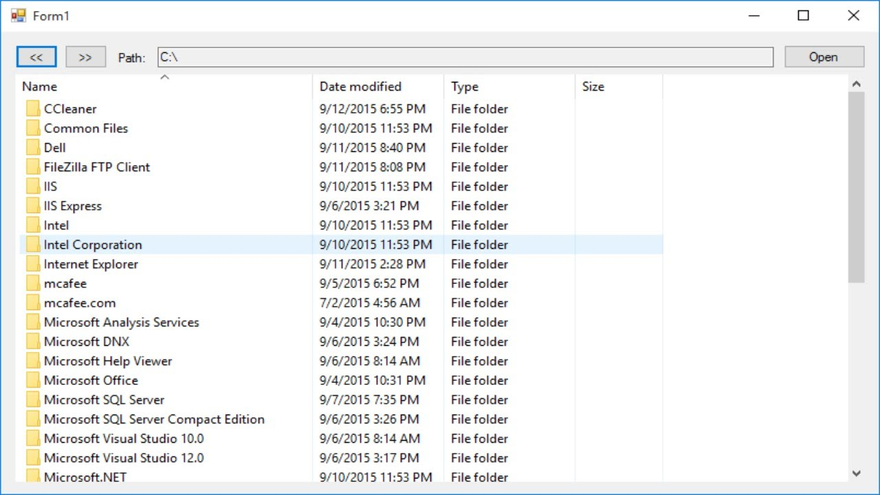
Assignment Week #3
Simple file explorer in C#
You can design UI or reference the next figure
basic folder navigation: double-click to open a folder, right-click for context-menu, …
Copy/cut/paste/delete folder and files. (Copy stream)
New folder
Plus point: allow copy large file ( > 5gb) (Hint: async, 2nd thread)

